Slide 1
NSQ1, Session 4
MongoDB Database design

Slide 2
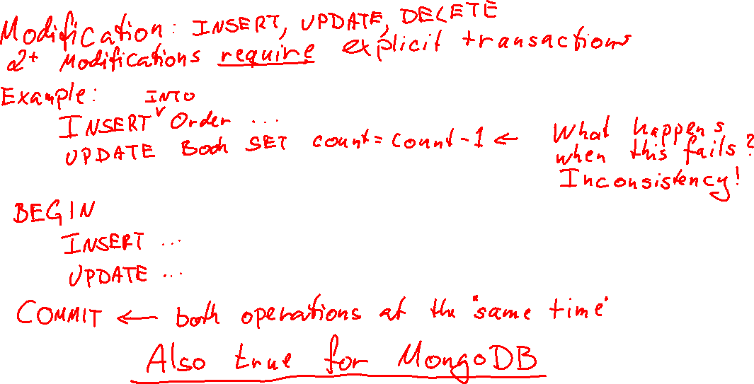
You forgot transactions

Slide 3
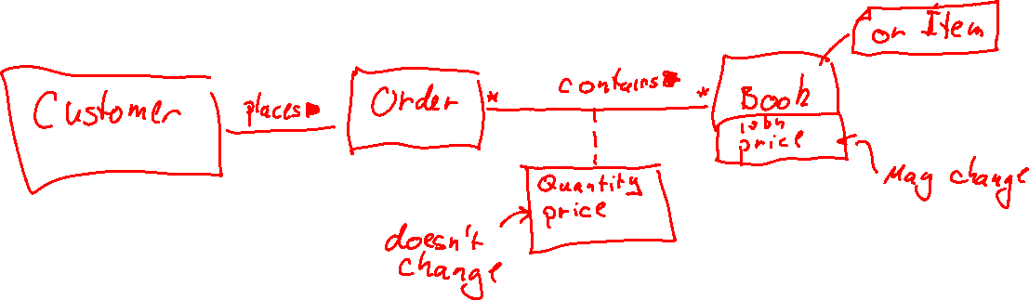
Modelling orders

Slide 4
Modelling Principles
“The optimal grouping of objects into collections is determined by the workload.” - Jay Runkel, Distinguished Solutions Architect, MongoDB
Nothing is wrong, but everything has consequences
The choice of embedding is determined by queries and how frequent they are
Data that's retrieved together should be stored together
Data that's not retrieved together should not be stored together
Redundancy is okay, but only when needed

Slide 5
Modelling options
1-1
Embed one object in the other
1-*
Refer to the parent object id from the child
Refer to the child objects as an array of object ids in the parent
Embed the parent object in the child
Embed an array of the child objects in the parent
*-*
Refer to the related objects as an array of object ids
Embed an array of the related objects

Slide 6

Embedding Pros and Cons
Pros:
Avoiding joins
Time performance
Easier queries
Cons
Redundancy
Worse space performance (disk space)
16MB limit

Slide 7
MongoDB Design Patterns
Pattern | Link
Approximation | https://www.mongodb.com/blog/post/building-with-patterns-the-approximation-pattern
* Attribute | https://www.mongodb.com/blog/post/building-with-patterns-the-attribute-pattern
Bucket | https://www.mongodb.com/blog/post/building-with-patterns-the-bucket-pattern
* Computed | https://www.mongodb.com/blog/post/building-with-patterns-the-computed-pattern
Document Versioning | https://www.mongodb.com/blog/post/building-with-patterns-the-document-versioning-pattern
* Extended Reference | https://www.mongodb.com/blog/post/building-with-patterns-the-extended-reference-pattern
Outlier | https://www.mongodb.com/blog/post/building-with-patterns-the-outlier-pattern
Pre-allocation | https://www.mongodb.com/blog/post/building-with-patterns-the-preallocation-pattern
* Polymorphic | https://www.mongodb.com/blog/post/building-with-patterns-the-polymorphic-pattern
Schema Versioning | https://www.mongodb.com/blog/post/building-with-patterns-the-schema-versioning-pattern
* Subset | https://www.mongodb.com/blog/post/building-with-patterns-the-subset-pattern
* Tree | https://www.mongodb.com/blog/post/building-with-patterns-the-tree-pattern

Slide 8
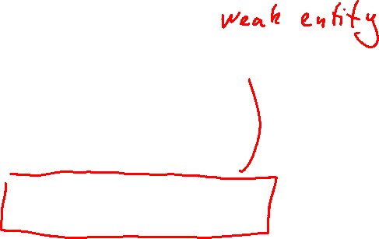
Attribute Pattern
Instead of this
Do this
{ name: "John Doe",
"mobile phone": "2885 6543",
"work phone": "8755 1234",
"land line": "7525 9137"
}
{ name: "John Doe",
phones: [
{ type: "mobile",
number: "2885 6543"},
{ type: "work",
number: "8755 1234"},
{ type: "land line",
number: "7525 9137"},
]
}

Slide 9
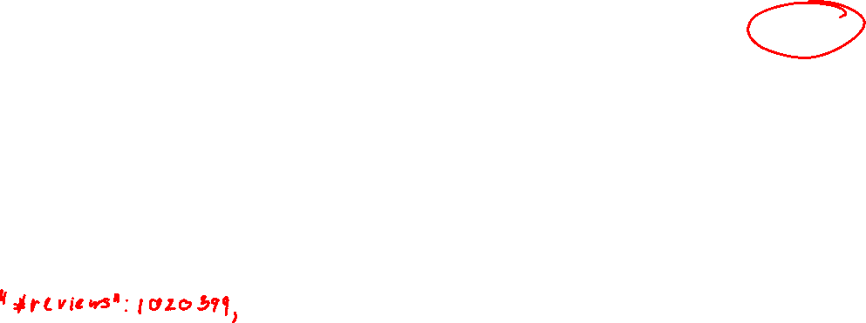
Computed Pattern
Instead of averaging 1M reviews on every read …
… update with every new review
{ title: "Alien",
year: 1979,
"average score": 8.5,
reviews: [{score: 7}, …]
}

Slide 10
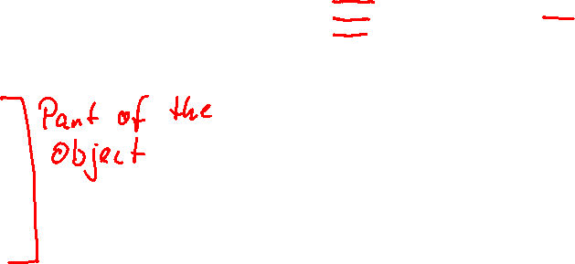
Extended Reference
[
{
role: ObjectId("AB53-…"),
title: "Alien³",
score: 6.4,
character: "Ripley",
year: 1992
},
…
]

Slide 11

Subset
An array of only the objects you want to show right now
The full set of objects are modelled according to the normal mapping options

Slide 12
Specializations ("inheritance")

Slide 13
Modelling specializations
In schemaless, no problem:
Manager: {staffNo, name, position, salary, mgrStartDate, bonus}
SalesPersonel: {staffNo, name, position, salary, salesArea, carAllowance}
These can live side by side in the same Staff collection
The problem is with creating a schema:
We can't forbid strange mixes: {staffNo, name, position, salary, salesArea, mgrStartDate}

Slide 14
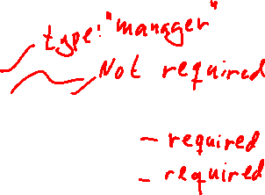
Polymorphic Pattern
{
staffNo,
name,
position,
salary,
manager: {
mgrStartDate,
bonus
}
}
{
staffNo,
name,
position,
salary,
salesPersonel: {
salesArea,
carAllowance
}
}

Slide 15
Recursive relationships
In relational mapping, dealt with like normal relationships
Typically, a reference to the parent
We can do the same in MongoDB:
Employee: {
_id,
manager_id,
…
}
There is another option: Tree Pattern

Slide 16
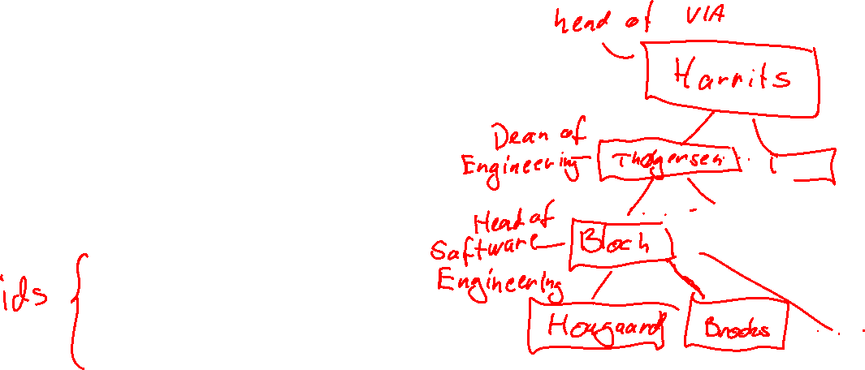
Tree Pattern
{
name: "Ole Hougaard",
title: "Associate Prof.",
managers: [
"Helle Bloch",
"Lotte Thøgersen",
"Gitte Sommer Harrits"
]
}

Slide 17
MongoDB JSON Schema
An example of a validator
A validator validates new (inserted) data
Either an error or a warning
A validator does not validate existing data
May or may not validate updated data

Slide 18
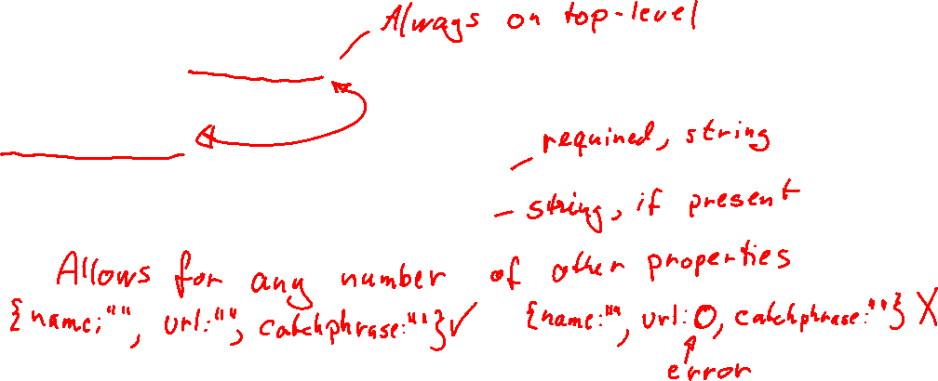
JSON Schema example
db.createCollection("performers", {
validator: {
$jsonSchema: {
bsonType: "object",
required: ["name"],
properties: {
name: {bsonType: "string"},
url: {bsonType: "string"}
}
}
})

Slide 19
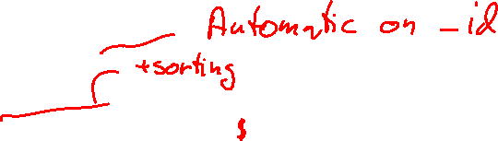
Indexes
Single Field Index
Used for filtering on a single field
Important for fields used in a lookup (Join)
Compound Field Index
Used for filtering on multiple fields
Used to create a "covering index"
Multikey Index
Used to index embedded arrays
Text Indexes
Used to speed up text search

Slide 20
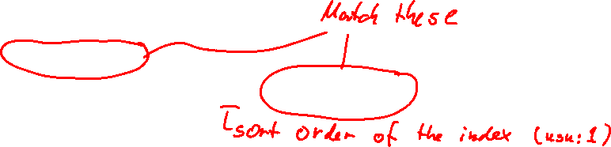
Covering
A query is covered by a compound index if all properties from the query are in the index
Example: db.cars.find( { manufacturer: 'Ford', cost: { $gt: 15000 } }).sort( { model: 1 } ) is covered by { manufacturer: 1, model: 1, cost: 1 }

Slide 21
Other compound index optimizations
ESR rule
When designing a compound index for a query, use this order
Equality - first the fields used to test for equality
Sort - then the fields used to sort the output (in the desired sort order)
Range - then the fields tested with $gt, $lt, etc.
Prefix of compound indexes
Like with relational databases, a prefix of a compound index is also used to speed up operations
{manufacturer: 1, model: 1, cost: 1} covers queries using only manufacturer and model (but not manufacturer and cost)
Use this to save on indexes

Slide 22
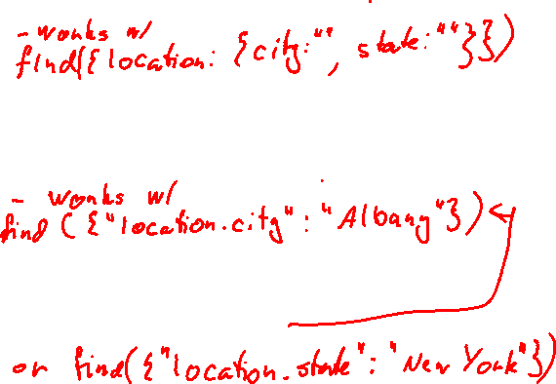
Embedding
[
{ "name": "Alice",
"gpa": 3.6,
"location": { city: "Sacramento", state: "California" }
},
{ "name": "Bob",
"gpa": 3.2,
"location": { city: "Albany", state: "New York" }
}
]
db.students.createIndex({
location:1
})
db.students.createIndex({
"location.city": 1
})
db.students.createIndex({
"location.$**": 1
})

